Slide 1
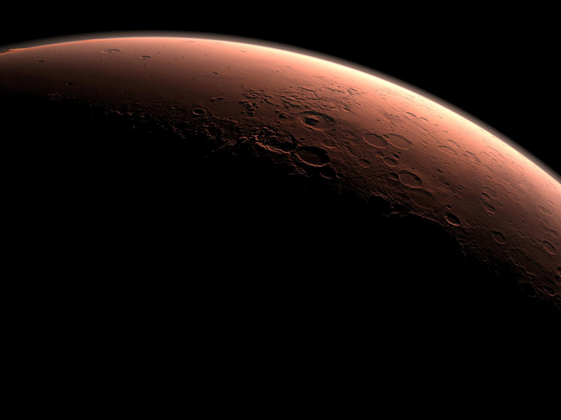
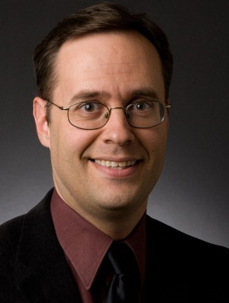
Inflatables:
Large, Immediate, Shielded Habitats
DOUG PLATA MD, MPH
Redlands, CA

Slide 2
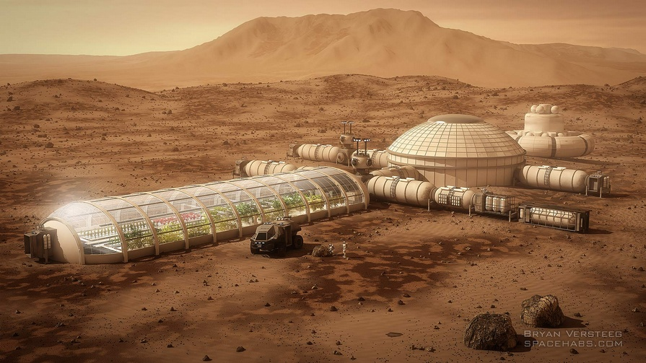
Applications
Notes:
2

Slide 3
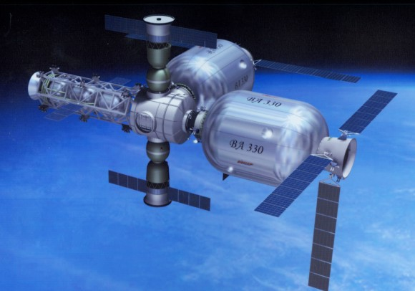
Low Earth Orbit

Slide 4
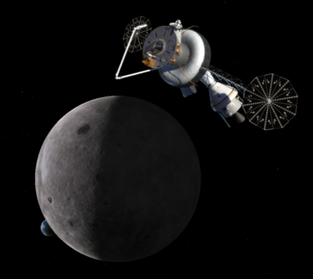
Earth-Moon Libration Point

Slide 5
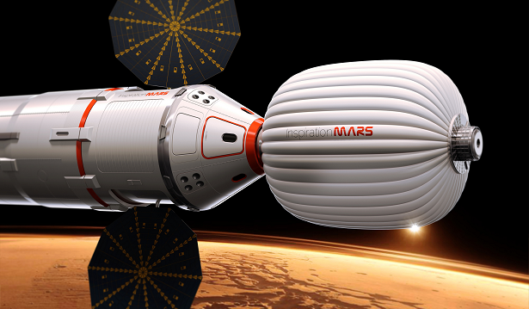
Interplanetary Travel

Slide 6
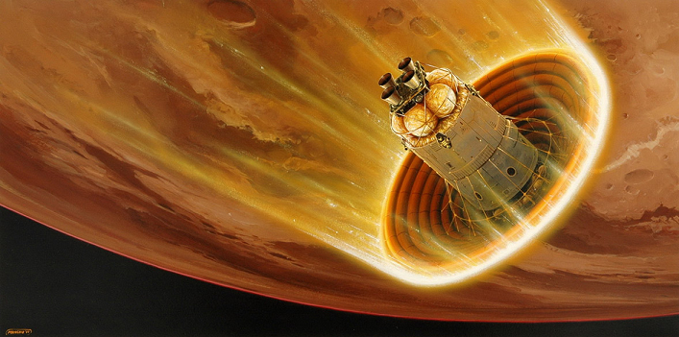
Aerobraking

Slide 7
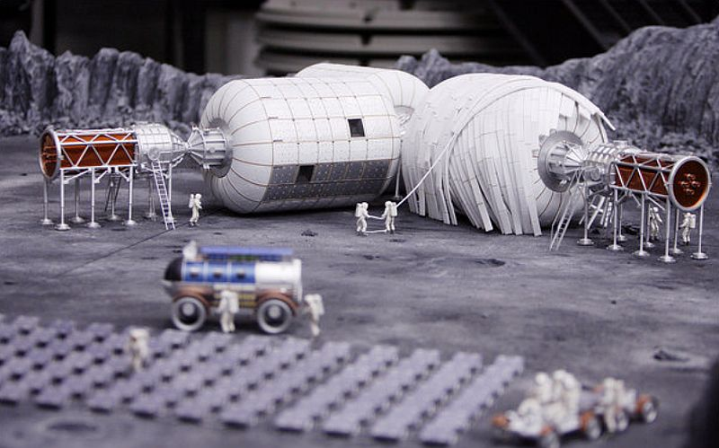
Lunar Base

Slide 8
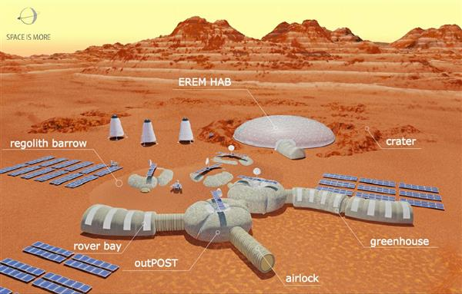
Mars Base

Slide 9
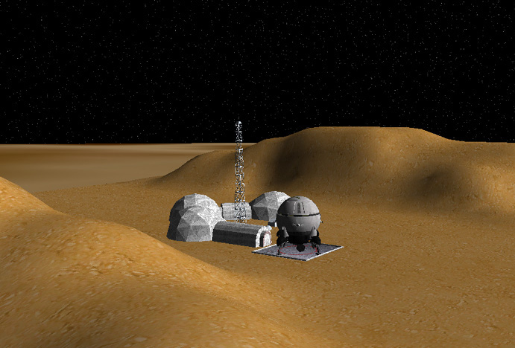
Phobos Outpost

Slide 10
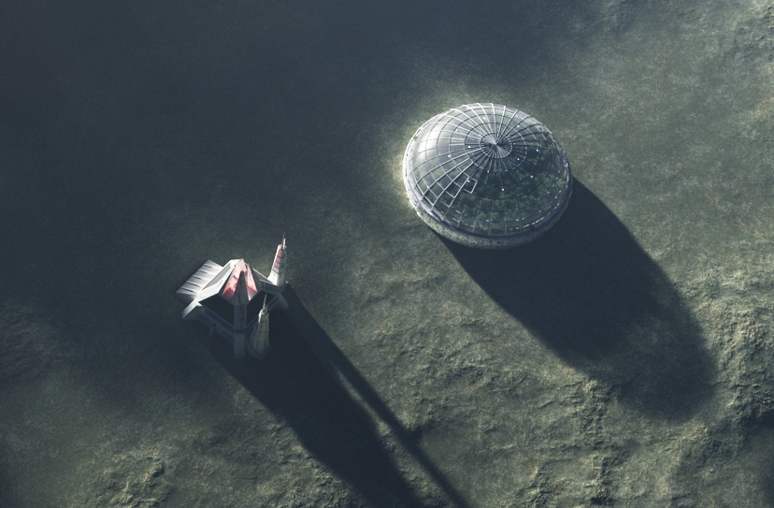
Asteroid Station

Slide 11
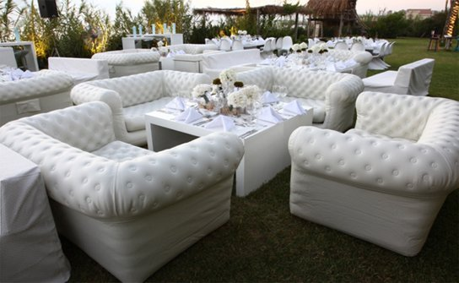
Furniture

Slide 12
Advantages
Notes:
12

Slide 13
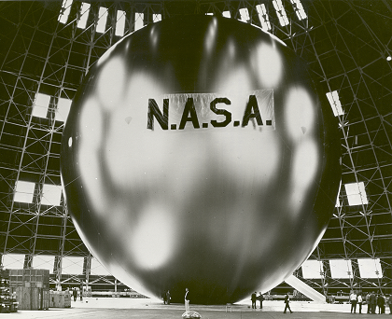
Advantages of Inflatables
Experience

Slide 14
Advantages of Inflatables
Experience

Slide 15
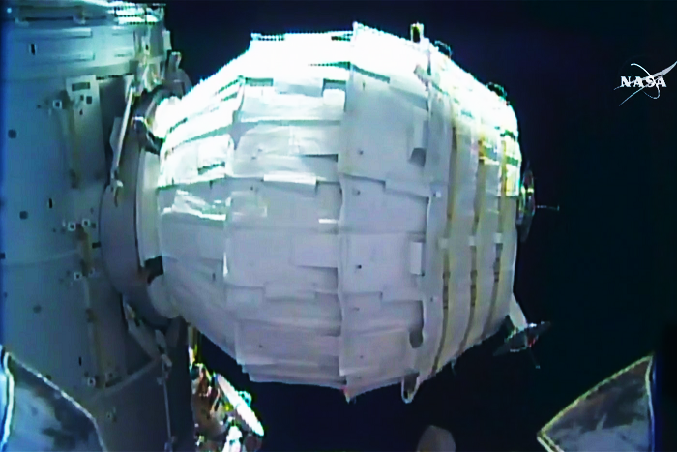
Advantages of Inflatables
Experience

Slide 16
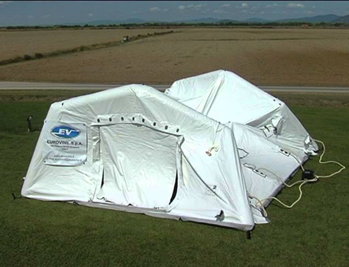
Advantages of Inflatables
Ease of Set-up

Slide 25
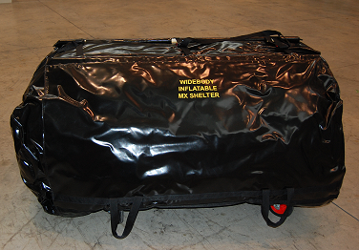
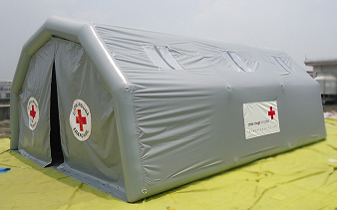
Advantages of Inflatables
Low mass – High volume

Slide 26
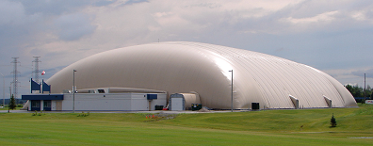
Advantages of Inflatables
Very large volume

Slide 27
Challenges
Notes:
27

Slide 28
Radiation
Notes:
28

Slide 29
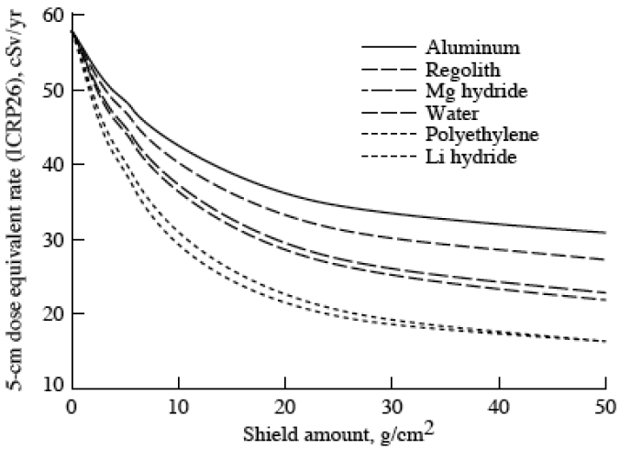
Radiation Shielding
Simonsen et al. 1997

Slide 30
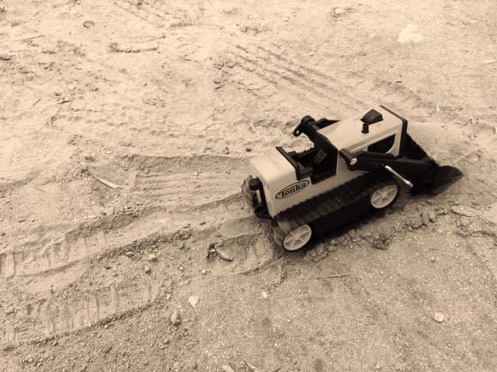
Radiation Shielding

Slide 31
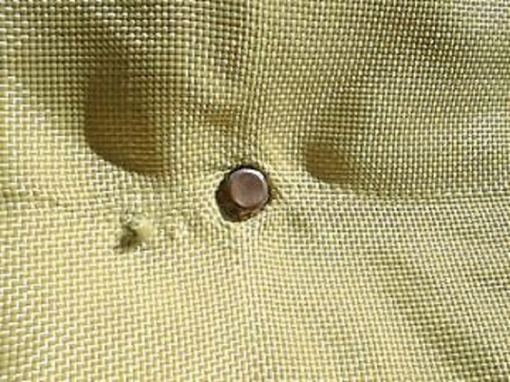
Punctures
Notes:
31

Slide 32
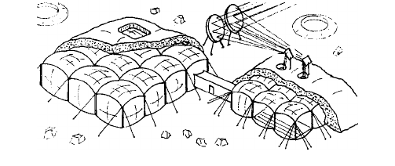
Punctures

Slide 33
Punctures

Slide 34
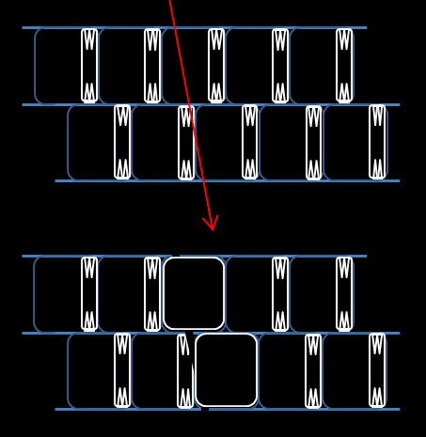
Punctures

Slide 35
Phases
Notes:
35

Slide 36
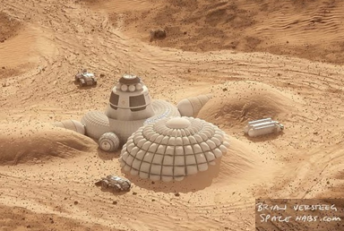
Phases

Slide 37
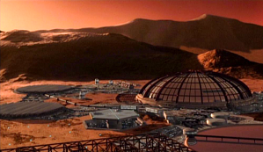
Phases

Slide 38
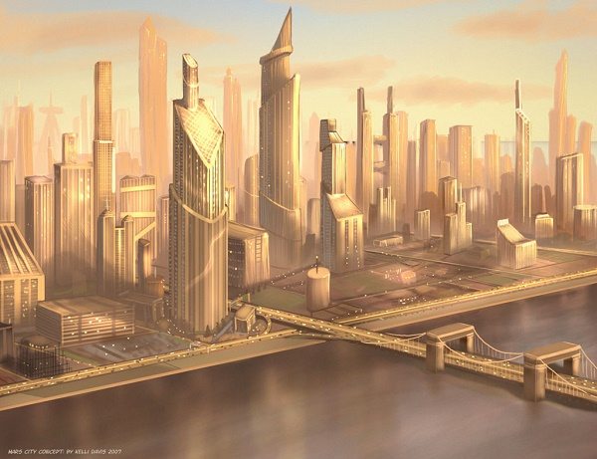
Phases

Slide 39
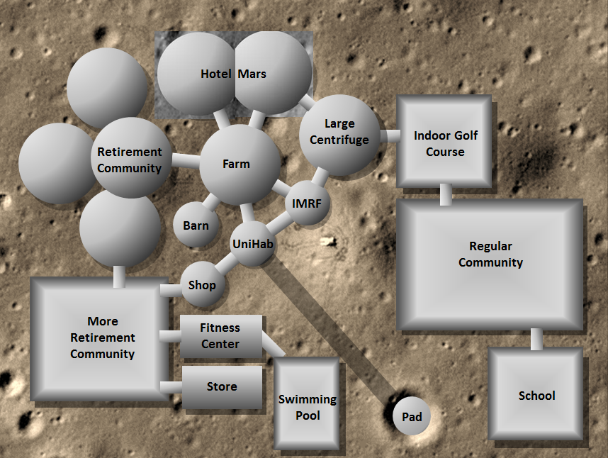
Phases

Slide 40
Very Large Inflatables
Notes:
40

Slide 41
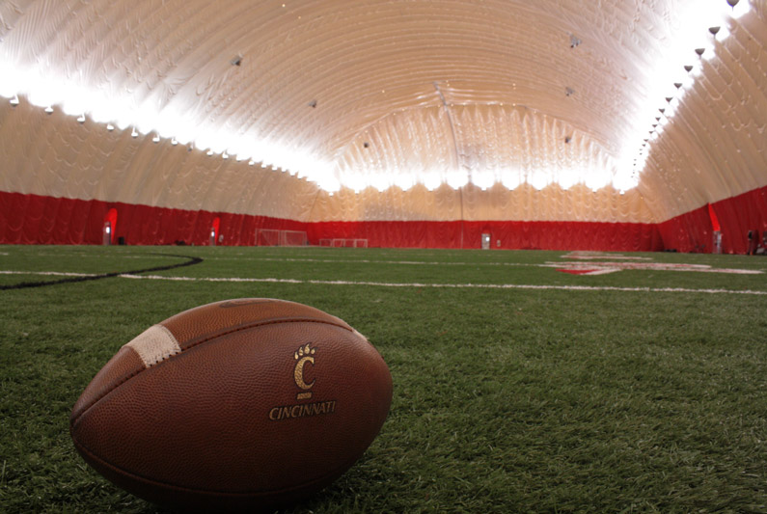
Very Large Inflatables

Slide 42
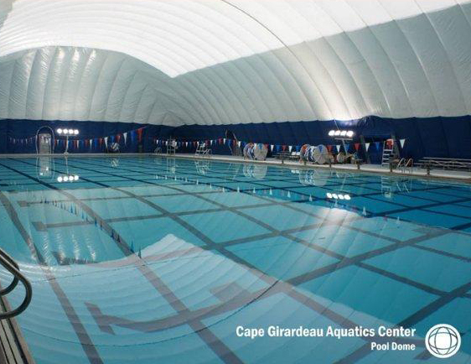
Very Large Inflatables

Slide 43
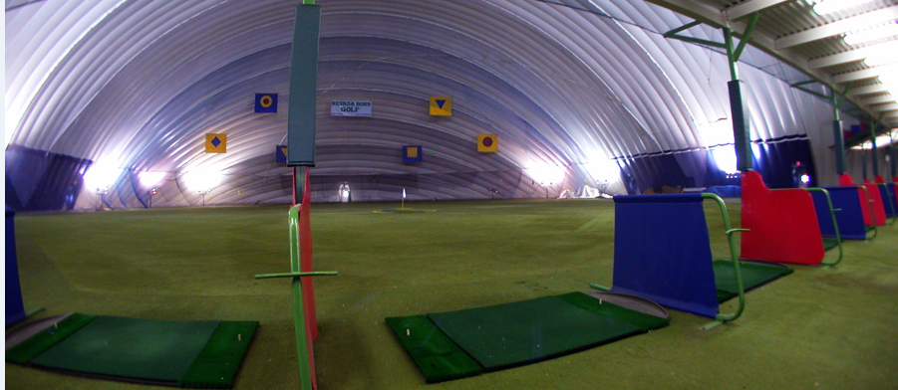
Very Large Inflatables

Slide 44
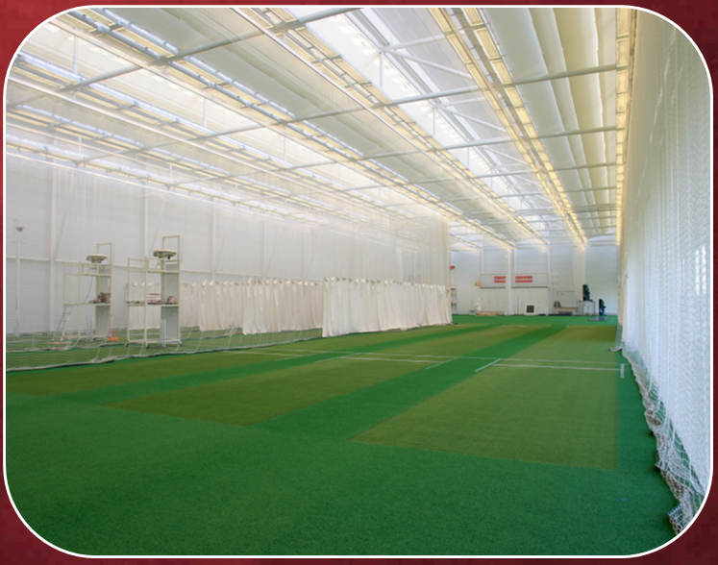
C. “Outdoors”
“Outdoors”
Notes:
44

Slide 45
Comparisons
Notes:
45

Slide 46
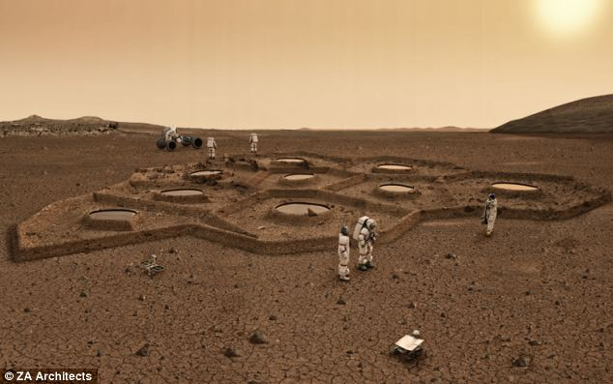
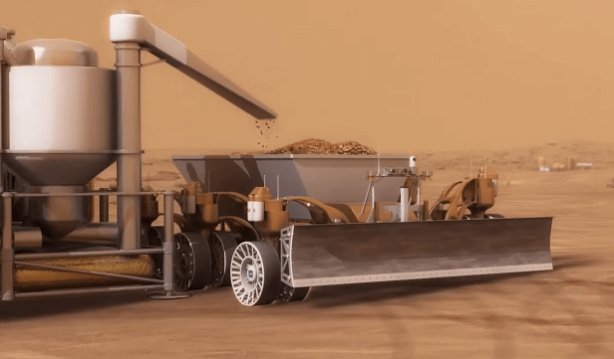
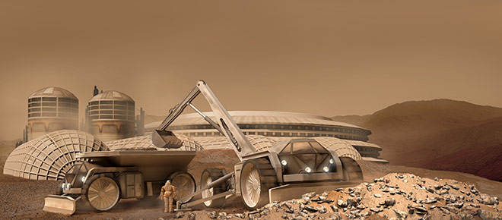
Compared With ISRU Construction

Slide 47
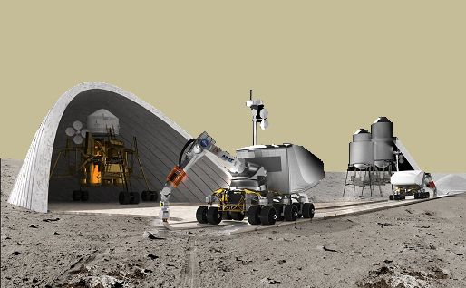
Compared With 3D Printing

Slide 48
Compared With 3D Printing

Slide 49
The UniHab
Notes:
49

Slide 50
The UniHab

Slide 51
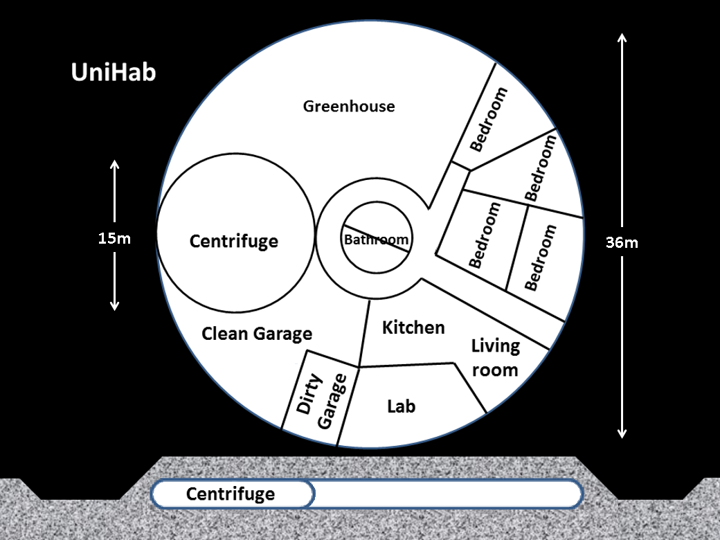
The UniHab

Slide 52
Centrifuge
Clean Garage
Hydroponic garden
Dirty Garage
Bathrooms
Kitchen
Labs
Bedrooms
Living Room

Slide 53
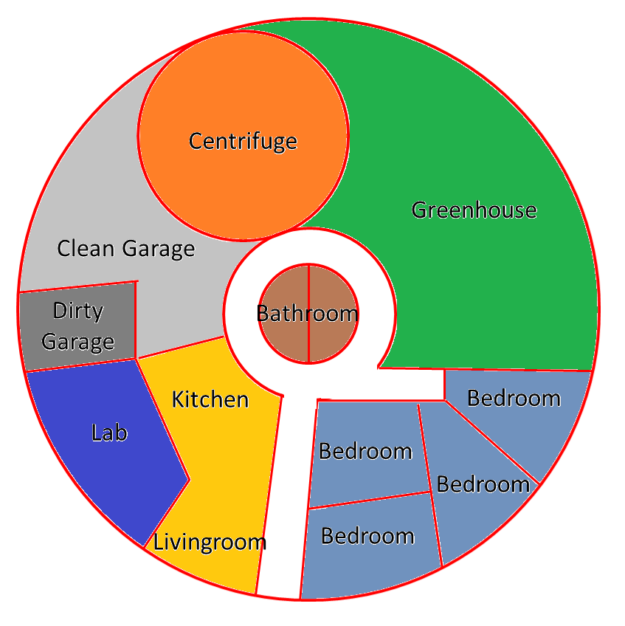

Slide 54
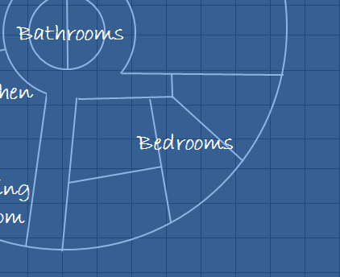
Bedrooms

Slide 55
Bedrooms

Slide 56
Bedrooms

Slide 57
Bedrooms

Slide 58
Bedrooms

Slide 59
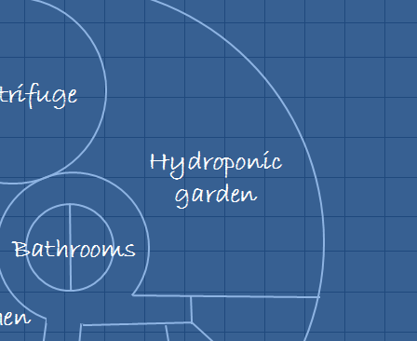
Greenhouse

Slide 60
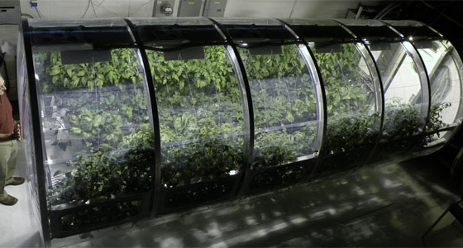
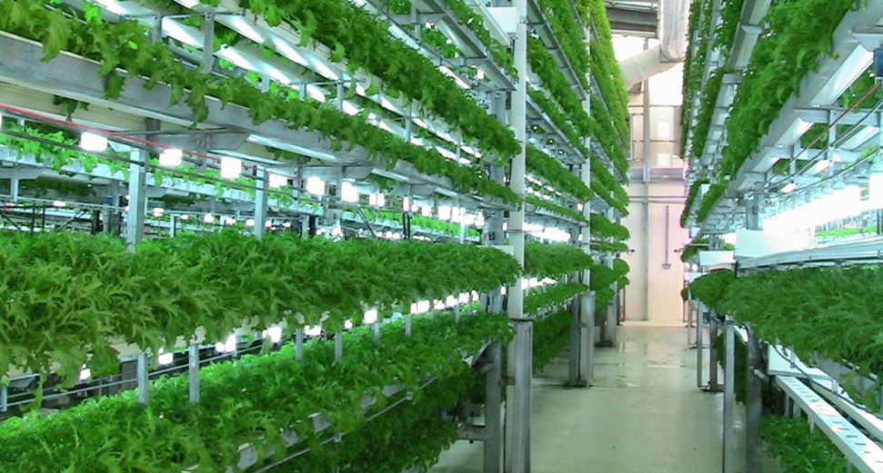
Greenhouse

Slide 61
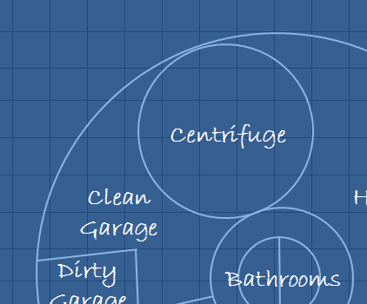
Centrifuge

Slide 62
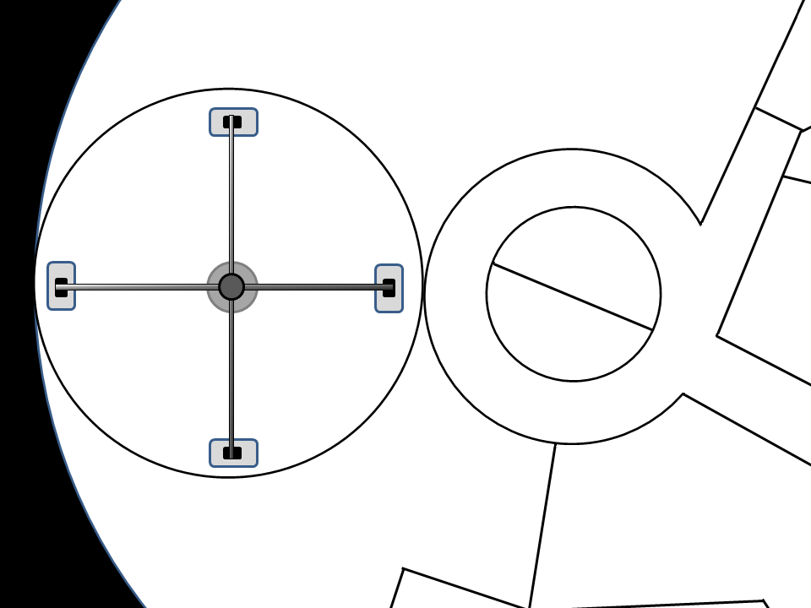
Centrifuge

Slide 63
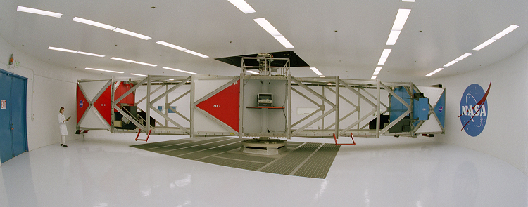
Centrifuge

Slide 64
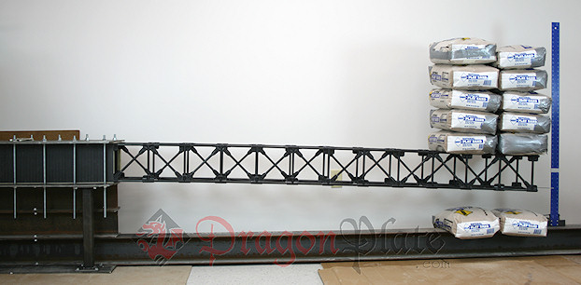
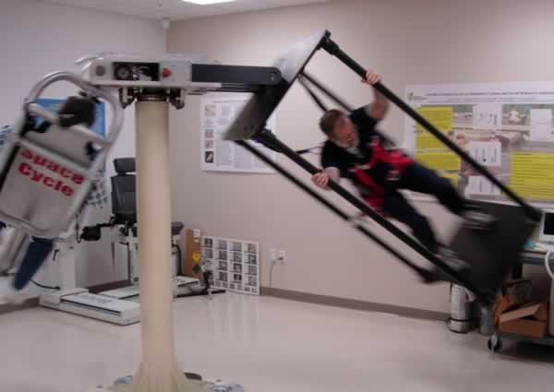
Centrifuge

Slide 65
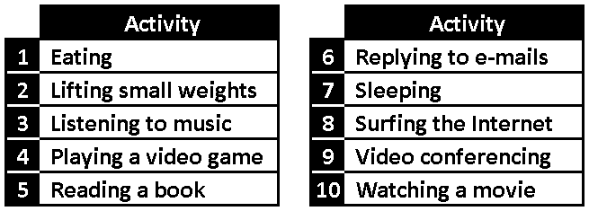
Centrifuge

Slide 66
Centrifuge

Slide 67
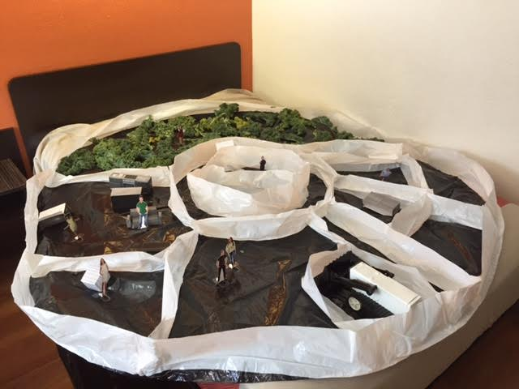
The UniHab

Slide 68
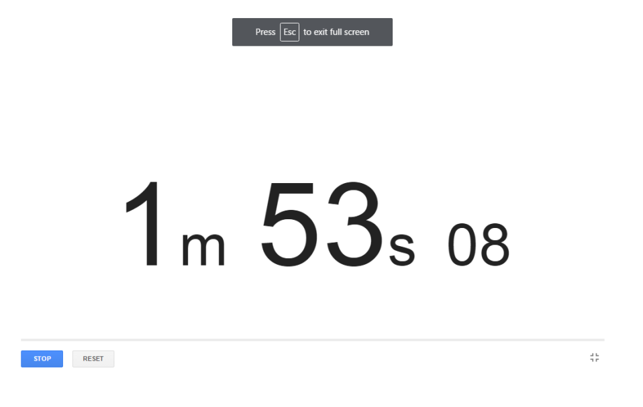

Slide 69
Thank you for your attention

